Slide 1
Scottish Water
Solution

Slide 2
Deal Overview

Slide 3
Our Solution theme aligned to Scottish Water’s goals

Slide 4
Our Target Operating Model
To be updated
Key principles:

Slide 5
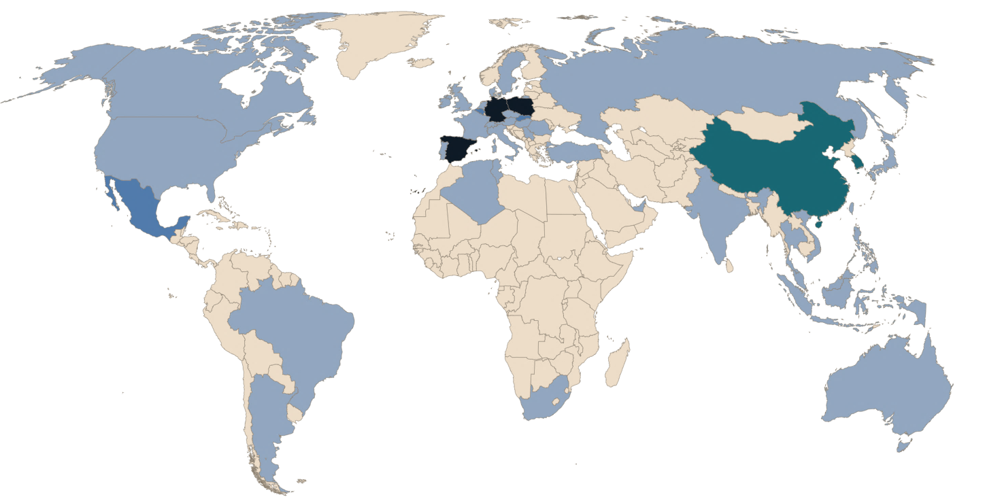
Delivery Locations
Scotland
Locations
Services
India
Locations
Services

Slide 6
Monitoring + Observability + AI

Slide 7
DEC Services

Slide 8
Service Desk Services
Scottish Water Outcomes
Scope
Volumetrics
Strategic Objectives
Enhance productivity and efficiency through innovation, automation and AI
Improve decision-making through data-driven insights
Empower and enable our people and partners to be more effective
Safeguard and protect our business and customers from cyber threats
Lot 2 - Digital Experience Centre, Service Outcomes – Key Differentiators
Proactive Preventative Maintenance & Monitoring
Zero Preventable Incidents
Business Contextualisation
Ticket Management / Knowledge Management / AI
Customer Experience
Solution Considerations/Assumptions
Tools/Accelerators (SW and Wipro)

Slide 9
How?
Zero Preventable Incidents
DCEM targets
Customer Experience
Proactive Preventative Maintenance & Monitoring
Business Contextualisation
Ticket Management / Knowledge Management / AI

Slide 10
ServiceNow (+ AI)

Slide 11
Assumptions and Clarifications from Scottish Water
Assumptions
***************
Clarification questions
*********************

Slide 12
Enterprise Applications

Slide 13
Enterprise Applications
Scottish Water Outcomes
Scope
Volumetrics
Strategic Objectives
Enhance productivity and efficiency through innovation, automation and AI
Improve decision-making through data-driven insights
Empower and enable our people and partners to be more effective
Safeguard and protect our business and customers from cyber threats
Enterprise applications, Service Outcomes – Key Differentiators
SLOs
Zero Preventable Incidents
Continuous Improvement/Innovation
Solution Considerations/Assumptions
Tools/Accelerators (SW and Wipro)

Slide 14
How?
Zero Preventable Incidents
DCEM targets
SLOs

Slide 15
Assumptions and Clarifications from Scottish Water
Assumptions
***************
Clarification questions
*********************

Slide 16
Azure Cloud Platform/Data Platform/M365

Slide 17
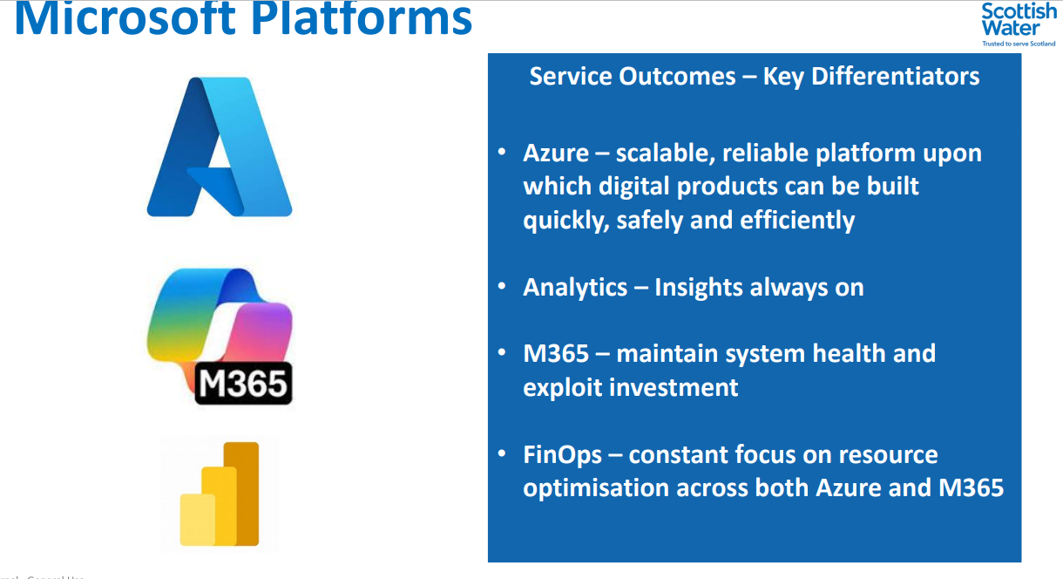
Azure Cloud Platform
Draft to be reviewed with practice
Scottish Water Outcomes
Scope
Volumetrics
Objectives
Provide a scalable, secure, and resilient cloud foundation for business-critical and line-of-business applications.
Enable DevSecOps and Infrastructure-as-Code (IaC) practices for agility and governance.
Ensure high service availability and platform evergreen compliance (e.g., patching, vulnerability mgmt.).
Implement FinOps visibility and optimization controls to manage cloud costs and usage.
Outcomes:
Scalability Auto-scaling infrastructure and apps respond to business demand changes.
Reliability 99.9%+ uptime; resilient architectures with proactive failover mechanisms.
Security & Compliance NIS, Zero Trust enforcement, and conditional access policies are applied.
Cost Optimization Rightsized resources and policy-based shutdowns reduce wastage.
Observability Unified alerting (via Monitor, Sentinel) drives ZPI and proactive ops.
Support for Azure-hosted applications, integration layers, automation scripts, APIs.
Management of resource groups, virtual networking, automation accounts, monitoring.
Evergreening of deployed infrastructure.
Secure design aligned to Zero Trust & NIS compliance.
Collaboration with engineering/OT environments
> 6,000 proactive support alerts/year (a large % tied to Azure workloads).
~160–180 Build Defects per month relate to cloud-hosted integrations.
24×7 support required for production-critical Azure services.
Solution Considerations/Assumptions
Tools/Accelerators (SW and Wipro)
Azure is the primary cloud platform for Scottish Water (ref: Digital Directorate section).
All changes, alerts, and health data must flow through ServiceNow.
Requires integration with tools like Sentinel, App Insights, Azure Monitor.
Assumes subscription-level visibility for partner-managed services.
CI/CD pipelines expected to follow DevSecOps and GitOps best practices.
Azure Monitor (alerting, telemetry, proactive threshold setting).
App Insights (application-level observability).
Azure Sentinel (security event correlation).
ARM templates / Bicep / Terraform for provisioning.
PowerShell / Azure CLI / Logic Apps for automation.
Accelerators for RCA, cost optimization, and auto-remediation workflows.

Slide 18
Data Cloud Platform (Azure + Power BI)
Draft to be reviewed with practice
Scottish Water Outcomes
Scope
Volumetrics
Objectives
Deliver a governed, secure, and unified analytics ecosystem using Azure Lakehouse, Synapse, and Power BI.
Enable data availability 24x7 for critical business operations, regulatory, and OT intelligence.
Support DataOps and automated pipeline monitoring to prevent data failures and improve trust.
Improve insight consumption and business decisioning through scalable dashboarding.
Outcomes
Pipeline Reliability Data refresh jobs monitored and recovered automatically via alerts.
Insight Timeliness Reports/dashboards delivered with SLA-defined freshness targets.
Semantic Layer Performance Fast queries and optimized visuals for decision-makers.
Governance & Lineage Data is catalogued, lineage mapped, and compliant with data policies.
User Empowerment Business users create and consume secure Power BI insights with confidence.
Management and enhancement of the Azure Lakehouse, Data Factory, Power BI, and Synapse services.
Ownership of data ingestion, pipeline health, orchestration, semantic layer performance.
Service support for analytical models, ML/AI integrations, and dashboards.
Ensure data governance, privacy compliance, and data cataloguing.
Data platform drives part of the Application Errors (~15–20%).
~10–15 Monthly ME/NDRs mapped to Data Engineering / Reporting enhancements.
24×7 support expected for data pipelines feeding critical reporting.
Solution Considerations/Assumptions
Tools/Accelerators (SW and Wipro)
Power BI is tightly integrated into enterprise workflows.
SW’s data products span structured + unstructured sources.
The solution must support both L1 triage and L3 deep data model support.
Requires DataOps-style Dev/Test/Data Quality frameworks.
Azure Data Factory / Synapse Pipelines for orchestration.
Azure Lakehouse (Delta Lake / LakeDB) for unified analytics.
Power BI + Power BI Gateway support packs.
Purview / Unity Catalogue (if integrated) for metadata lineage.
In-house accelerators: data validation templates, pipeline health dashboards, alert correlation scripts.

Slide 19
M365
Draft to be reviewed with practice
Scottish Water Outcomes
Scope
Volumetrics
Objectives:
Maintain system health and user experience across Microsoft 365 suite (Teams, Outlook, SharePoint, etc.).
Exploit the investment by driving adoption, automating routine tasks, and reducing service tickets.
Enhance employee collaboration and digital workplace productivity.
Govern the Power Platform ecosystem with security, lifecycle, and analytics controls.
Outcomes:
Service Health Device sync, license issues, Teams outages proactively resolved via Intune/NexThink.
Experience Improvement DCEM scores improve due to reduced “chase” calls and better communication.
Adoption & ROI Power Automate, SharePoint, and Teams usage increases via digital champions.
Support Ticket Reduction Self-service and virtual agents reduce how-to and access request volumes.
Governance & Security DLP, Conditional Access, and tenant controls enforce data security posture.
Full application management of:
SharePoint Online, Teams, OneDrive, Outlook, Exchange Online
MS Forms, Planner, Power Automate, Viva
Enablement of user support, governance enforcement, and usage optimisation.
Platform support for digital workplace collaboration.
Request management (access, permissions, provisioning, device sync issues).
> 3,100 Password-related issues linked to M365 identity platform.
> 1,900 How-to questions (~70% M365 related).
> 10,000+ Service Requests (hardware/software/admin) intersect with M365 endpoints.
Solution Considerations/Assumptions
Tools/Accelerators (SW and Wipro)
M365 is a core pillar of Scottish Water’s Digital Experience Centre (DEC).
24x7 user support model required.
Usage and adoption of new features tied to employee personas via Employee Center.
Must support AI-based ticket categorization, virtual agents, and user journeys in Teams.
Power Platform components (e.g., Automate, Apps) included in enhancement scope.
Microsoft Graph API (automated provisioning, access logging).
Power Platform Admin Center (environment governance).
M365 Admin Center, Teams Admin Center, Intune, Endpoint Analytics.
Integration with NexThink for proactive user experience monitoring.
RPA, virtual agent accelerators for:
Self-reset password
Join/Leave Teams
Assign mailbox, OneDrive storage expansion

Slide 20
How?
Draft to be reviewed with practice
Zero Preventable Incidents (ZPI)
Digital Customer Experience Measure (DCEM)
Cloud Financial Operations (FinOps)
What is it? A strategic target where no incident should occur if it could have been predicted, detected, or prevented with monitoring, testing, governance, or change control.
What is it? A multi-metric performance index used by Scottish Water to quantify the end-user digital experience. It focuses on sentiment, system usability, performance, and resolution effectiveness.
What is it? FinOps is the practice of managing cloud cost, usage, and value — especially in Azure and data platforms. It’s about balancing cost control with speed and value delivery.
How ZPI Works in Practice?
What makes up DCEM?
FinOps Principles
Practice Area | Contribution to ZPI
Monitoring & AIOps | Detect anomalies before failures (e.g. CPU spike alerts)
Automated Testing | Prevent code regressions or config drift
Change Control | Prevent incidents from poorly tested deployments
Knowledge Mgmt | Avoid “known error” tickets recurring
Proactive Service Desk | Resolve before user impact (via NexThink or Intune)
RCA Loop | Root cause analysis closes the loop on repeat issues
Pillar | Example Metric
Self-Service Success | % issues resolved via portal or chatbot
Communication Quality | # of chase calls / % updates sent proactively
Time-to-Resolution | Median time to close incident
First Contact Resolution | % resolved on first touch
Sentiment/Survey | CSAT/Net Promoter Score after ticket close
Knowledge Utilization | % of tickets deflected via KB use
Practice Area | Contribution to ZPI
Cost Visibility | Understand costs by resource, app, owner
Optimization | Rightsizing, removing idle resources
Forecasting | Monthly usage patterns → project cost trends
Accountability | Showback/Chargeback per team or app
Policy Enforcement | Resource tagging, budget alerts, quota limits
Cost Visibility | Understand costs by resource, app, owner
Azure FinOps Tools
Azure Cost Management + Billing
Budgets, Alerts, Reservations
Workbooks for chargeback modelling
Azure Policy / Tagging Compliance
Kusto Queries to track spend spikes
KPI | Description | Target*
% Repeat Incidents per App | Number of recurring issues | < 2%
% Avoidable Incidents | Based on RCA flag | 0 (long term)
Time to Implement RCA Fix | How quickly a root cause fix is deployed | < 5 working days
% Issues Resolved Proactively | Closed before end-user complaint | > 40%
ZPI KPI Examples
DCEM > ZPI Strategy
A ZPI culture drives DCEM improvements — when issues are prevented, user experience improves.
Automated insights from NexThink + ServiceNow feed both ZPI and DCEM tracking.
Chase calls (a DCEM detractor) often point to avoidable miscommunications — fixable under ZPI.
FinOps Lever Impact on ZPI & DCEM
Auto-shutdown policies Avoid unplanned outages or noisy neighbor issues (ZPI)
Rightsizing compute Improve app responsiveness (DCEM)
Proactive budget alerts Avoid resource cut-off impacting service users.
Monitoring high-cost growth Catch runaway processes linked to defects

Slide 21
How?
Draft to be reviewed with practice
Azure
Capability | How It Ensures Scalability & Reliability
Auto-scaling & Load Distribution | Azure App Services, AKS & Functions scale dynamically on load
Infrastructure-as-Code (IaC) | Repeatable, version-controlled deployments (Terraform/Bicep)
Multi-region Architecture | Geo-redundancy with active/passive or active/active configurations
App Insights & Azure Monitor | Proactive issue detection, dependency mapping, SLAs tracking
Zero Trust & Policy Compliance | Platform hardening, conditional access, tagging and audit policies
Azure Blueprints / Landing Zones | Governed onboarding of new services
FinOps Practices | Right-sizing, cost visibility, quota alerts
Strategy:
We design and operate Azure-hosted services using resilience patterns, automation, and FinOps principles to ensure that the platform scales seamlessly, is cost-optimized, and remains highly available for all line-of-business and digital apps.
Outcomes: Zero business disruption from platform events (ZPI); Self-healing infrastructure and alerts; Predictable, repeatable platform scaling for data & apps; Hardened compliance to NIS & ISO27001
Analytics
Capability | How It Enables Always-On Insights
Lakehouse Architecture | Unified source for raw, curated, and semantic layers
Data Factory + Synapse Pipelines | Orchestrate batch + near real-time ingestion (error-handled)
Power BI Premium Capacity Management | Ensures performance, caching, and refresh optimisation
Monitoring & Alerting | Detect failed jobs, refresh delays, permission issues
Purview / Catalogs | Trace data lineage, control data ownership
DataOps Practices | Versioning, testing, governance for analytics pipelines
Always-On SLA Monitoring | Use Kusto queries + Workbooks for latency and freshness tracking
Strategy:
We manage Scottish Water’s Azure-based Data Lakehouse, Synapse, Power BI, and ADF pipelines as a continuous, resilient, and governed ecosystem — designed for 24/7 analytical availability and insight generation.
Outcomes: Reliable delivery of dashboards and reports (e.g. regulatory, OT, asset data), No refresh failures or broken visuals in Power BI, Predictive alerting for ingestion pipeline failures, Improved trust in data, insight-led business decisions
Microsoft 365
Capability | How It Maintains Health & Drives ROI
M365 Admin Center + Intune Monitoring | Track sync issues, patch compliance, license status
Proactive Ticket Prevention (NexThink) | Detect endpoint issues before user complaints
Power Platform Governance | Enforce DLP, environment guardrails, app lifecycle
Viva Insights | Drive adoption and user wellness visibility
Self-service Enablement via Employee Center | Reduces request volume, boosts experience
M365 Change Awareness | Integrate Microsoft release roadmap into service readiness
Security & Compliance Dashboards | Track access, sharing, shadow IT, and regulatory compliance
Strategy:
Our approach treats Microsoft 365 as a digital experience platform, not just a productivity suite. We combine system health monitoring, admin governance, user behaviour insights, and automation to ensure performance, adoption, and value realization.
Outcomes: Reduction in M365 “How-to” and password-related incidents, Better alignment of M365 use to employee roles & personas, Monitoring-driven performance and security compliance, Increased adoption of Power Automate, SharePoint, Teams

Slide 22
Assumptions and Clarifications from Scottish Water
Assumptions
***************
Clarification questions
*********************
To be updated

Slide 23
SR27

Slide 24
SR 27
Scottish Water Outcomes
Solution
SR 27 operating model objectives
Better business outcomes at lower cost and carbon
Adaptive and more agile model – product orientated
New capabilities in Digital engineering and AI
Accelerates us towards our Strategic Ambitions

Slide 25
Projects

Slide 26
Projects
Draft to be reviewed with practice
Scottish Water Outcomes
Solution Tenets
Objectives
Strategic Delivery: Deliver discrete, outcome-focused projects aligned with Scottish Water’s digital priorities.
Agile and Predictable Execution: Apply Agile and/or PRINCE2 disciplines to deliver value early and often.
Robust Governance: Operate within a gated model (G30-G110) with measurable project health at each stage.
Business Value Realization: Align each initiative to clear business benefits and outcomes (IPOD, IFAC measures).
Right-Sized Planning & Estimation: Build accurate resource/cost/benefit forecasts at initiation phase.
Compliance & Risk Awareness: Deliver secure, NIS-aligned, financially auditable projects.
Capacity Enablement: Augment Scottish Water capabilities via skilled professionals in hybrid teams.
Outcomes
High-quality, scalable digital solutions: Delivered on time, on budget, per design specs.
Gate-aligned progress and assurance: Gate 30–110 outcomes traceable via progress, cost, and KPI reporting.
Reduced variance and drift: Forecast vs actual metrics monitored; corrective plans initiated if needed.
Knowledge transfer and sustainment: Projects leave documented artefacts and trained teams for BAU transition.
Value Realisation via KPIs: IPOD (delivery), IFAC (costs), PCL (commitments) consistently met or exceeded.
Tenet | Description
Agile + Gated Hybrid Delivery | Use PRINCE2 & MSP-aligned G30–G110 gates with Agile delivery within phases
Delivery Readiness Assurance | Architecture, requirements, and resource readiness embedded in early gates
Fusion Team Model | Blended teams of SW, partner, and niche SMEs enable knowledge & control
Outcomes-Driven Business Cases | Every project includes impact, cost-benefit, and risk-adjusted justification
Design for Operability | Every project must plan for ZPI, supportability, and evergreen operation
Digital Twin + Integration Ready | Projects consider OT/IT convergence, system interoperability
Secure by Design | All solutions must meet Scottish Water’s cyber, data, and compliance standards
Key Considerations
Area | Consideration
Governance | Gate-based checkpoints (G30 to G110), IPOD/IFAC used for outcomes tracking
Tooling & Traceability | ADO, SharePoint, ServiceNow used for traceability, artefact storage, reporting
People & Skills | Project teams must scale as needed with specialist access on-demand
Documentation & Handover | All project artefacts: HLDs, LLDs, test scripts, training material, SOPs
Knowledge Transfer | Structured KT before BAU transition; support for DEC & app teams
Risk & Issue Management | Risk exposure and mitigation updated at every gate, aligned with Unifier logs
Commercial Control | Forecast-to-actual tracked monthly; variances justified and corrected
Security & Resilience | All implementations comply with Zero Trust, cyber, DR, HA expectations
Project Performance Measurement Framework
Measure | Purpose | Aligned KPIs
PCL | % of projects reaching G90 on time and on budget | G30–G90 success
IPOD | Delivery completion as per baseline scope | G90–G110
IFAC | Budget outturns vs forecasted committed costs | Cost adherence
Milestone Drift | Actual vs planned dates for critical gates/milestones | Gate slippage
Risk Exposure | Quantified residual risk across active project portfolio | Risk log, Unifier
Customer Satisfaction | Quality perception via stakeholder survey or DCEM inputs | Post-G100

Slide 27
Appendix

Slide 28
LIMS APPLICATION MIGRATION & AMS

Slide 29
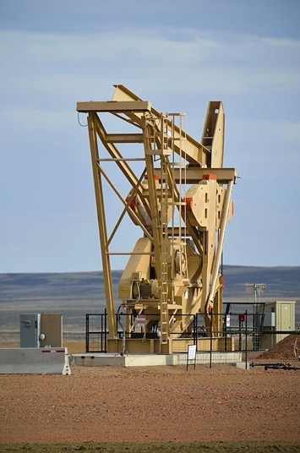
LIMS Migration on-premise LIMS Applications to a cloud computing model Infrastructure as a Service (IaaS)
The Client
Benefits
Thames Water, UK
National Grid, UK
Fortum, Finland
Automation solution for lab end users
Formalized process for incidents and requests and quick turn around.
Making LIMS Centralized and making it available24 X 7 through Cluster Manager & NLB
Our Credentials
The Challenge
Maintenance, support upgrade and migration of LabWare LIMS.
Co-ordinate with Vendor and other customer support teams to carry out support functions so that there is potential reduction in cycle time of support calls and saving of costs
Work with Business, QA, Vendor and other customer support teams to perform Change Management and maintain validated status of applications
Required to Improve Services and reduce cost
The Solution
24X7 reliable support (including on-call support during non-business hours) with responsiveness less than 30 minutes
Upgrading of the exiting LIMS System
Transitioning from Labware Thick Client to Web Client.
Making the LIMS available as a web solution
Team of 2 experience LIMS consultants with Techno functional expertise.
Fixing the existing bugs
Supporting the application to address regular incidents and enhancements.
Effective handling of release management to provide faster solutions for changes requested.
Integrates with other IRIS applications and external system such as SAP, ROMSS, data acquisitionand historian systems.
Extensive Knowledge transfer on the application.
29

Slide 30
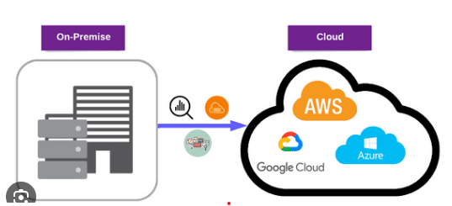
LIMS On-Premise to Cloud Migration
Benefit | Key Features
Operational | Scalability ,Reliability, Disaster Recovery.
Financial | Reduced IT costs
Security | Advanced protection,compliance.
Agility | Faster deployments,innovation support
Management | Centralized tools,automation,analytics.

